Slide 1

GRP LIMITED
ANNUAL GENERAL
MEETING
FY2026 BUSINESS OVERVIEW
23 October 2026
Mission : GRP is committed to maximising value to shareholders

Slide 2
IMPORTANT INFORMATION
Disclaimer
• Confidentiality: This presentation includes privileged and confidential information. Copying or distribution is prohibited. If received in error, delete all copies and notify GRP Limited at investor@grp.com.sg.
• Forward-looking statements: This presentation may contain statements subject to risks and uncertainties. Actual outcomes may differ materially from projections, and the Company assumes no obligation to update such statements after the presentation date.
• Risk factors may include industry and economic conditions, interest rates and cost of capital, competition, occupancy and rental income, collections, operating expenses, public policy changes, and availability of financing.
• Readers should not place undue reliance on forward-looking statements, which reflect management’s current perspective. Content is protected by copyright. Prior written consent is required to reproduce non-textual content.
© 2026 GRP Limited. All rights reserved.
GRP LIMITED | AGM FY2026
02

Slide 3
BUSINESS REVIEW
FY2026 at a glance
REVENUE
LOSS BEFORE TAX
LOSS AFTER TAX
CASH & EQUIVALENTS
S$20.61m
S$3.38m
S$3.67m
S$10.93m
+165.6% year-on-year
FY2025: S$8.59m loss
FY2025: S$8.79m loss
As at FY2026
What shaped the year
• Revenue growth was driven by the Measuring Instruments segment (+11.9% YoY) and the return of positive property segment revenue (>100% YoY).
• Losses reduced significantly year-on-year (> 50%), while the Group still retained a meaningful cash balance, as significant portion of the fund are being utilised to complete the affordable housing project.
• Management remains focused on project execution, financial discipline and sustainable growth through exploring new business possibilities.
GRP LIMITED | AGM FY2026
03

Slide 4
PERFORMANCE
Revenue by business segment
FY2026 Revenue Mix
Revenue (S$’000)
MEASURING INSTRUMENTS
S$15.40m
+11.9% vs FY2025
PROPERTY
S$5.20m
Returned to +ve Revenue
(Discontinued)
Total: S$20.61m
GRP LIMITED | AGM FY2026
04

Slide 5
KEY FINANCIAL INDICATORS
A resilient balance sheet – high cash and no gearing
CASH / EQUIVALENTS
NET ASSET VALUE
CURRENT RATIO
BANK DEBT
S$10.93m
S$21.46m
1.97×
Nil
FY2026
FY2026
Current assets / liabilities
FY2026
S$’000 | FY2026 | FY2025
Cash & Cash Equiv* | 10,927 | 19,517
Total Assets | 43,290 | 43,826
Total Liabilities | 21,835 | 19,472
Net Asset Value (NAV) | 21,455 | 24,354
Cash as % of NAV | 50.93% | 80.14%
Debt (Bank Loan) | - | 194
Debt-to-Equity Ratio | - | 0.008
Equity per Share | $0.119 | $0.135
EQUITY PER SHARE
S$0.119
Market closing $0.07 @ 30 Jun ’26 and Cash accounts for 51% of NAV
* FY2025 cash balance includes S$2.01m restricted bank balance. The decrease in FY2026 cash balance was largely due to fund being utilised to complete the affordable housing project.
GRP LIMITED | AGM FY2026
05

Slide 6
SHAREHOLDER PERSPECTIVE
Total shareholder return (TSR)
TSR includes share-price movement plus dividends and distributions in specie (DIS)
10-YEAR TSR | 2016–2026
5-YEAR TSR | 2021–2026
−15.81%
−18.74%
Share price: 23.28¢ → 7.00¢
Share price: 18.30¢ → 7.00¢
10-year Shareholder Value Components
5-year Shareholder Value Components
• Dividends received: 1.50¢
• DIS received: 11.10¢
• Dividends paid: 0.50¢ in FY2019; 1.00¢ in FY2020
• DIS values reflect distributions of LFHL shares in 2016 and 2021
• Dividends received: nil
• DIS received: 7.87¢
• DIS values reflect distributions of LFHL shares in 2021
GRP LIMITED | AGM FY2026
06

Slide 7
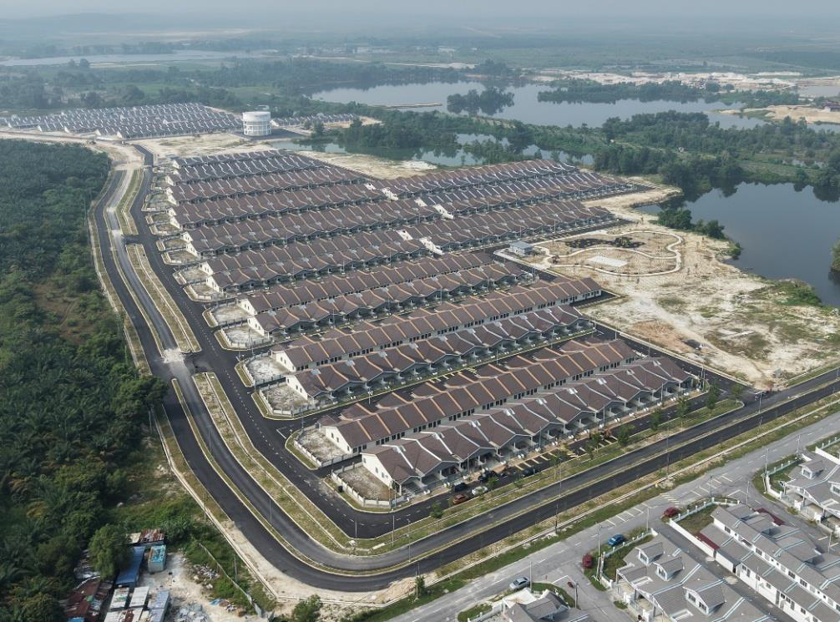
CONSTRUCTION UPDATE
Property Segment | Phase 1
465 units (RM 145K/unit)
• All 464 completed units sold (1 left)
• Pre-CCC obtained on 6 April 2026
• Infrastructure works largely completed
• Expected Full CCC by end Oct 2026
CCC – Certificate of Completion and Compliance
GRP LIMITED | AGM FY2026
09

Slide 8
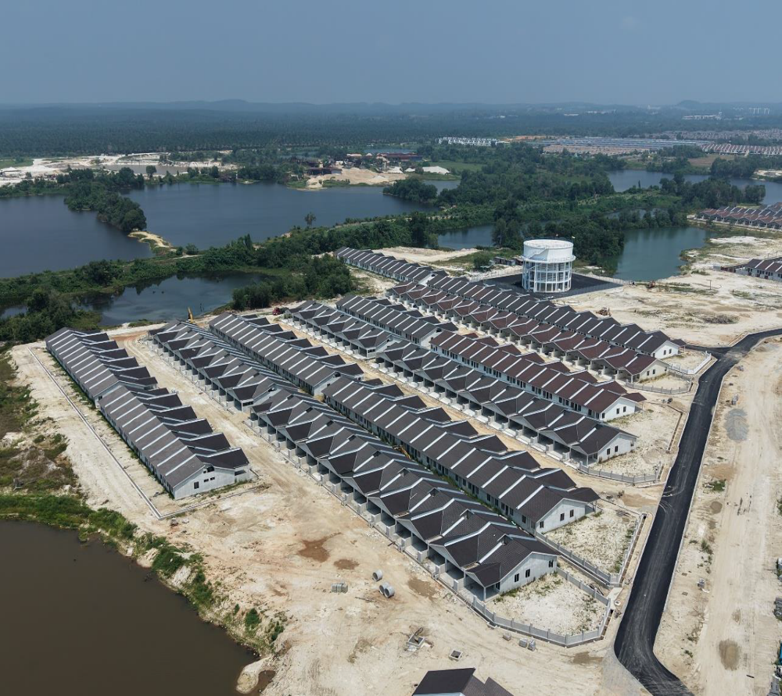
CONSTRUCTION UPDATE
Property Segment | Phase 2
270 units (RM 169K/unit)
• 98 completed units sold (172 left)
• Building works 90% completed
• Infrastructure works 70% completed
• Expected Full CCC by Dec 2026
GRP LIMITED | AGM FY2026
09

Slide 9
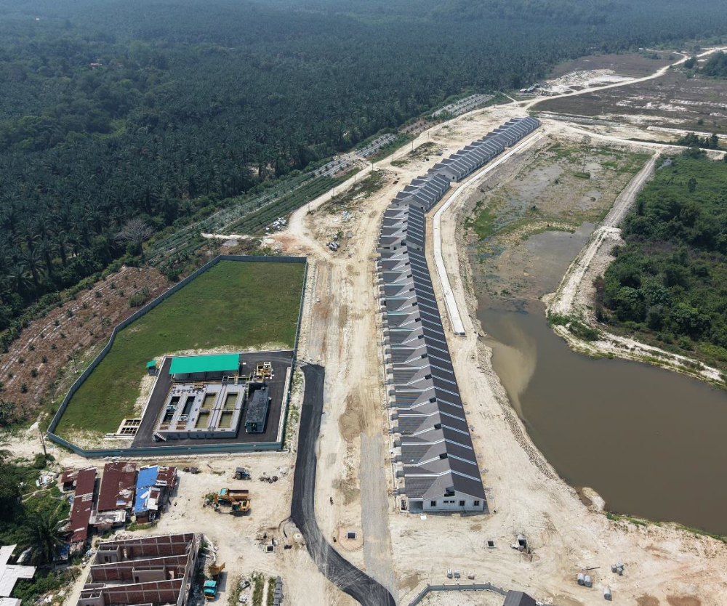
CONSTRUCTION UPDATE
Property Segment | Phase 2
67 Linear units
• Building works 100% completed
• All not released for sales yet
• Selling Point : Beautiful Water Detention Pond Behind
• Expected Full CCC by Dec 2026
GRP LIMITED | AGM FY2026
09

Slide 10
CONSTRUCTION UPDATE
Property Segment | All 3 Phases (1,039 units +28 Shop Houses)
PHASE 1
PHASE 2
PHASE 3
270 units + 28 Shop Houses
465 units
304 units
REPORT CARD
REPORT CARD
REPORT CARD
Building Works 90% Done
Infrastructures 70% Done
Assess Commencement of Works after Phase 2 CCC
99% Sold
NEXT FOCUS
NEXT FOCUS
NEXT FOCUS
CCC by end Oct 2026
Launch Sales / Obtain CCC by Dec 2026
CCC by Dec 2027
GRP LIMITED | AGM FY2026
11

Slide 11
GRP LIMITED
Moving Forward | Property Segment
Resolve outstanding disputes
Continue to pursue resolution to close outstanding matters
01
Prioritise Phase 1 and Phase 2 completion, subject to construction progress and required CCC approvals
Complete and hand over homes
02
Broaden the Sales Pipeline
Seek new sales launches and expand access to the general public. Increase in unit selling price
03
Maintain Financial Discipline
Delivering positive operating cash flow, forge a good working relationship with the Authorities for LAD recoverable and support the community for a Liveable housing neighbourhood
04
GRP LIMITED | AGM FY2026
12

Slide 12
GRP LIMITED
Strategic Growth & New Opportunities
Mission: Maximising Value to Shareholders
• Explore strategic expansion into renewable energy, battery energy storage systems, food resilience and sustainable technology.
• Consider mergers, alliances and acquisitions that align with Group’s strategy that offers long-term value creation.
• Apply disciplined evaluation: earnings accretion potential, transformative acquisition and integration costs for strategic value-creation with synergies, and good governance with risk mitigation.
• Prioritise projects that are Good and profitable, Right and sustainable, and also Providential — an acronym for GRP and fundamentally its philosophy.
Thank you
23 October 2026 | Annual General Meeting

