Slide 1

AGM 24 October 2025
GRP LIMITED
1

Slide 2
Disclaimer
This presentation includes privileged and confidential information; any copying or distribution of this material, or any information it contains, is strictly prohibited. If you have received this presentation in error, please delete all physical and digital copies and notify GRP Limited (GRP) via email at investor@grp.com.sg.
This presentation may contain forward-looking statements that involve risks and uncertainties. Actual future performance, outcomes, and results may differ significantly from those projected in forward-looking statements due to various risks, uncertainties, and assumptions. The Company assumes no obligation to update these forward-looking statements following events or circumstances that occur after the date of this presentation.
Examples of such factors include, but are not limited to, prevailing industry and economic conditions, interest rate fluctuations, cost of capital, competition from other developments or companies, changes in expected occupancy levels, property rental income, charge-out collections, fluctuations in operating expenses (including employee wages, benefits, and training costs), governmental and public policy modifications, and the ongoing availability of financing at necessary amounts and terms to support future business activities.
We advise against placing undue reliance on these forward-looking statements, which reflect the current perspective of GRP’s management regarding future events.
Unless stated otherwise, all content contained within this document is protected by copyright owned by GRP Limited. Prior written consent from GRP is mandatory if you intend to reproduce, distribute, or utilize any non-textual contents (including but not limited to photographs, graphics, illustrations, diagrams, audio files, and video files) contained in this document for any reason or purpose.
© 2025 GRP Limited. All rights reserved.
2

Slide 3
2025 Business Review
Revenue of $7.76 million in FY2025
Highlights
• Revenue of $7.76 million, 56.8% lower than revenue of $ 17.97 million in FY2024.
• Loss before tax of $8.59 million in the year under review as compared to a loss of $0.06 million in FY2024.
• Loss after tax of $8.79 million in FY2025, as compared to the loss of $0.36 in FY 2024
• Balance sheet remains strong – the Group’s cash & cash equivalents are presently at $19.52 million.
Revenue
Property – FY2025 (-$5.994M, >100.0% lower than FY2024 of $5.747M.
Measuring Instruments – FY2025 $13.755M, 12.6% higher than FY2024 of $12.218M.
3

Slide 4
Key Financial Indicators
Balance sheet remains healthy – High cash levels and low gearing
Cash accounts for 80% of NAV
✓
(S$'000) | 2025 | 2024
Cash & Cash Equiv.* | 19,517 | 17,567
Total Assets | 43,826 | 45,410
Total Liabilities | 19,472 | 12,553
Net Asset Value (NAV) | 24,354 | 32,857
Cash as % of NAV | 80.14% | 53.47%
* FY2025 balance is Inclusive of $2.011M restricted bank balance.
low gearing (debt-to-equity ratio – 0.008)
Debt composition: Enterprise Financing Scheme Temporary Bridging Loan. Interest charged at 2% per annum with a tenure of 5 years till Dec 2025.
✓
(S$’000) | 2025 | 2024
Debt (Bank loans) | 194 | 576
Total Equity | 24,354 | 32,857
Debt to Equity Ratio | 0.008 | 0.018
Equity per share ($) | 0.135 | 0.182
Number of Shares | 180.197M | 180.197M
Current Ratio =
Total Current Assets/
Total Current Liabilities
= 2.21
4

Slide 5
Total Shareholder Return (TSR)
TSR is expressed as a percentage, including the price appreciation of a share plus any dividends paid during the performance period.
TSR = (Current Price - Purchase Price + Dividend) / Purchase Price
Dividend (Cents)
Paid in FY2019 | 0.50
Paid in FY2020 | 1.00
✓
Total Shareholder Return (TSR)
Over 10 years period (2015 to 2025) | Cents
- Closing Share Price at 1 Jul 2015 | 34.28
- Closing Share Price at 1 Jul 2025 | 7.00
- Dividend received from 2015 to 2025 | 1.50
- DIS received from 2015 to 2025 | 11.10
TSR for past 10 years (2015 to 2025) | -42.82%
Over 5 years period (2020 to 2025) | Cents
- Closing Share Price at 1 Jul 2020 | 19.90
- Closing Share Price at 1 Jul 2025 | 7.00
- Dividend received from 2020 to 2025 | 1.00
- DIS received from 2020 to 2025 | 7.87
TSR for past 5 years (2020 to 2025) | -20.25%
7 October 2016 - Shareholders of the Company, for each ordinary share held in the Company - had a DIS of 0.17 shares of Starland Holdings Limited now known as Luminor Financial Holdings Limited (LFHL). Total of 23,718,245 LFHL shares were distributed. As at 7 October 2016, shares of LFHL traded at $0.19; Value of the DIS per ordinary share in the Company is $0.0323 (i.e $0.19 * 0.17)
3 December 2021 - Shareholders of the Company - had a DIS of 2 LFHL shares for 3 shares held in the Company. Total of 120,130,358 LFHL shares were distributed. At 3 December 2021, shares of LFHL traded at $0.118; Value of the DIS per ordinary share in the Company is $0.0787 (i.e.0.118 * 2/3)
5

Slide 6
Property Segment
Project: Affordable housing project in Seri Iskandar for development of 1,039 terraces houses and 28 shop units
Milestones 2 Dec 2020 Ratus Nautika Sdn Bhd (“RNSB”) entered into a Joint Venture Development Agreement ("JVDA") and was designated by Lembaga Perumahan Dan Hartanah, Perak ("LPHP") as the developer for the Group’s inaugural housing project (the “Project”) located in Seri Iskandar, Perak, Malaysia. 26 Jul 2021 Awarded the contract to Energiser Enterprise Sdn Bhd ("EESB") as the principal contractor for the project.
11 Nov 2021 Official launch of the Project sales. 10 Feb 2025 RNSB issued Notice of Determination, terminating EESB with immediate effect.
20 Feb 2025 RNSB issued Request for Arbitration to EESB and Arbitration has been commenced at Asian International Arbitration Centre. An arbitrator has been appointed and directions have been provided by the arbitrator during 1st preliminary meeting on 7 Oct 2025.
1 May 2025 New Contractor RSK Global Visions (M) Sdn Bhd (“RSK”) has been appointed to carry on and complete the Project.
Back on Track
The Group is putting its best efforts to complete Phase 1 and 2 of the Project by March 2026 and Phase 3, the last phase of the Project, by December 2026. As for the differences with EESB, the Group is working towards resolving all the disputes and claims with EESB through the arbitration proceeding so as to close the chapter with EESB.
Construction Delay &
Disputes in FY2024
GRP Limited
6

Slide 7
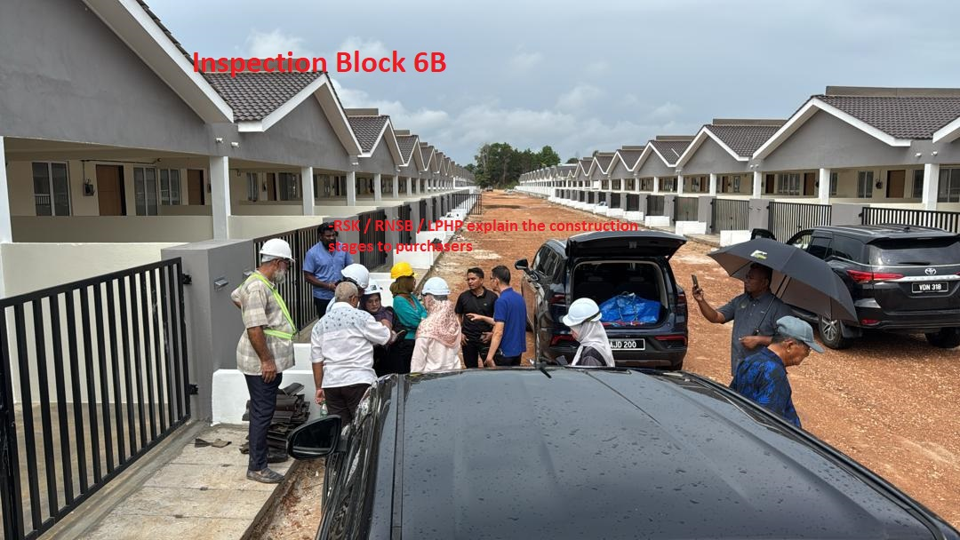
Property Segment – Customer’s Day Event
Our local partner LPHP together with RNSB, organized Customer’s Day on 28 Aug 2025 attended by 10 representatives.
A briefing of the status of Phase 1 Completion and a tour of the site to witness the progress and to check on built quality ended with positive overwhelming Q&A session.
Overall customer representatives were happy to see the project moving again and look forward to receiving their units in the 1st Quarter 2026.
The Project is now able to sell to the general public on top of the uniform groups.
Dining Hall
GRP Limited
7

Slide 8
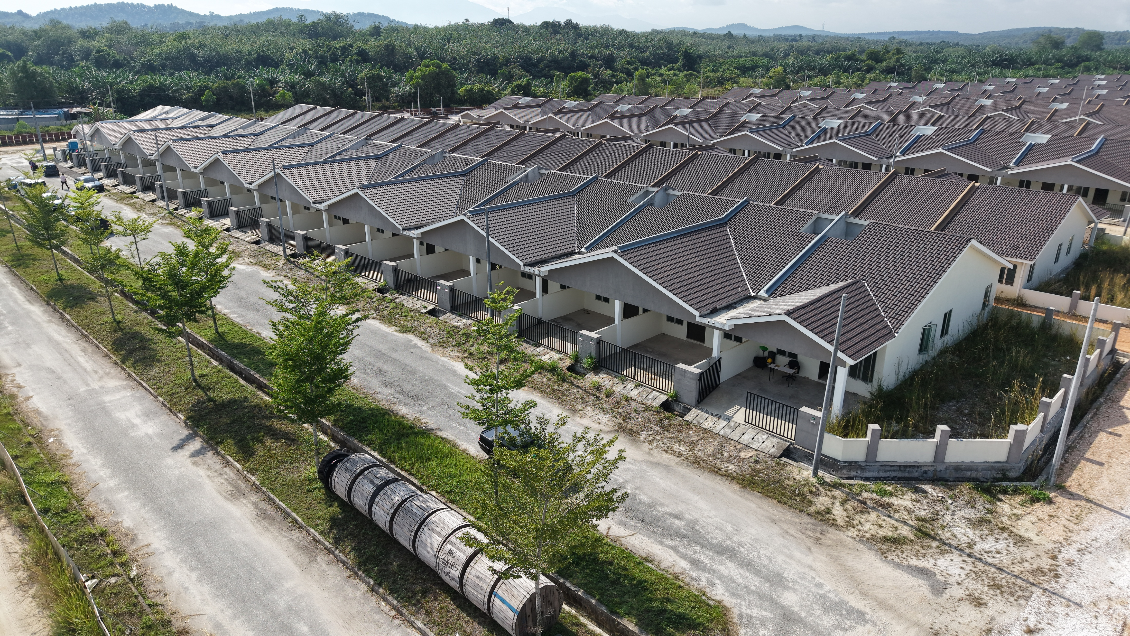
Property Segment Phase 1
Update FY2025
Update FY2024
8

Slide 9
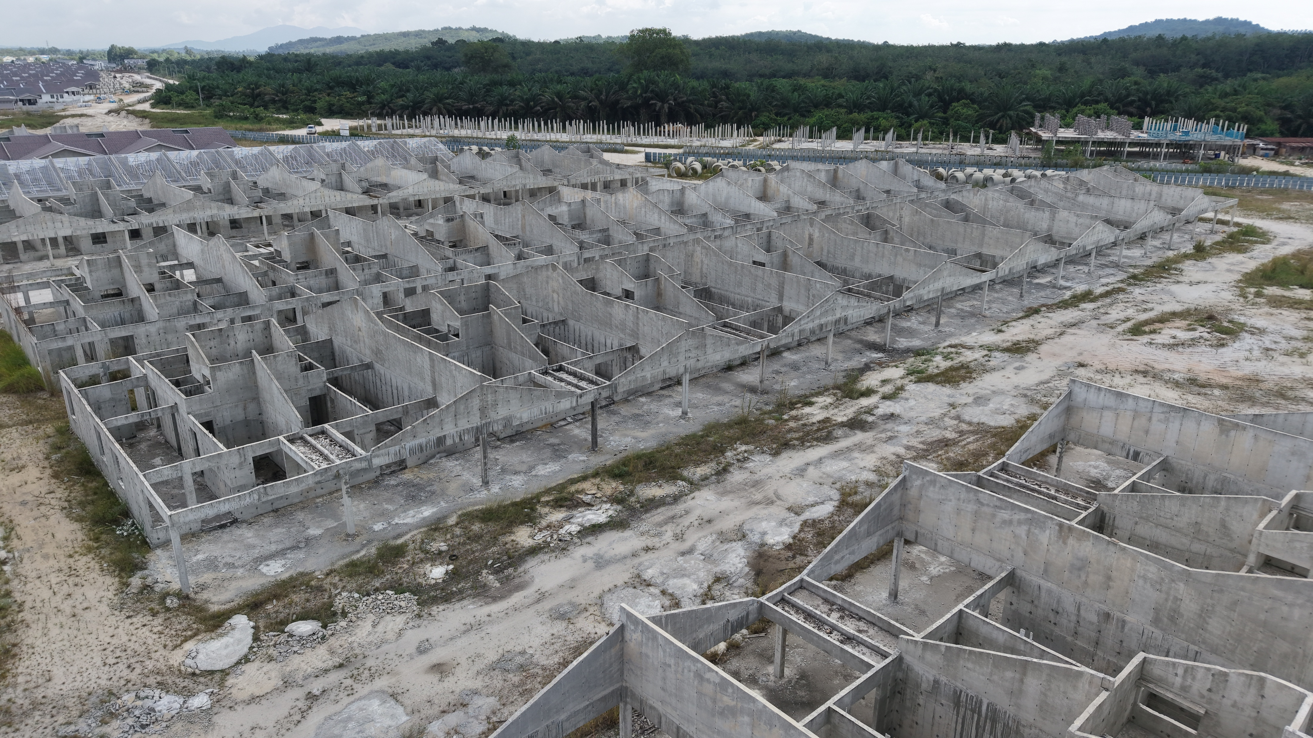

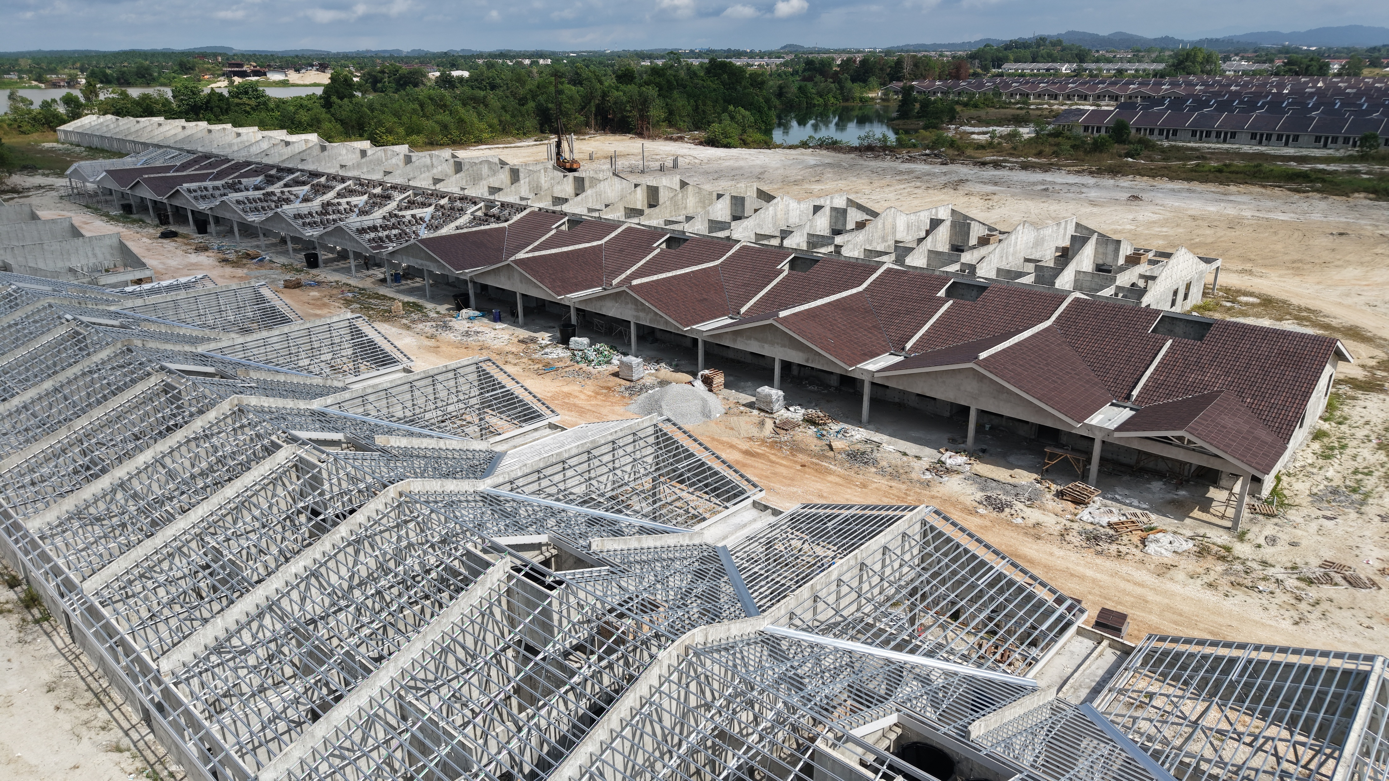
Property Segment Phase 2
Update FY2025
9

Slide 10
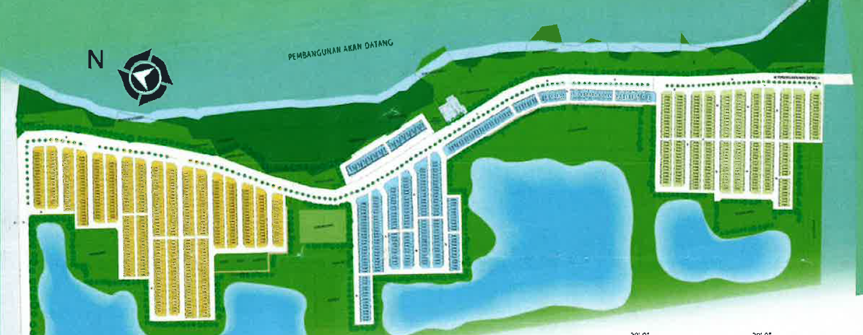
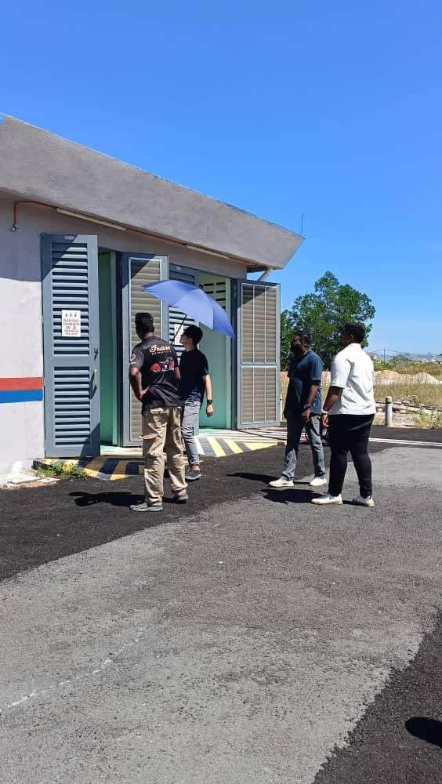
Property Segment All Three Phases
TNB Sub-station
Phase 3 (304 units) Completed: 0 Target Completion: By Dec 2026 Work will commence only after completion of Phase 1 & 2
Phase 1 (465 units) Completed: 465 pending interior furnishing. Target completion: Mar 2026 with Water Tank completion to accomplish TOP/CCC
Phase 2 (270 units & 8 Shops House) Completed: 22 units with roof covered. Target Completion: Mar 2026 with Water Tank completion to accomplish TOP/CCC
10

Slide 11
Moving Forward
Putting the House in Order
Back on Track in Property Segment
Robust Financial Statements Reporting
Complete Phase 1 & 2 by March 2026 and Phase 3, the last phase of the Project, by December 2026
Auditors had issued a Clean (i.e. without a disclaimer) Opinion on the Company’s Financial Statements FY2025
Seek new Sales launch with target opens up to general public
Continue to Sustain Clean Opinion
Actively pursuing towards resolving all disputes and claims from EESB through the arbitration proceeding
Observe Positive Cash Flows Generated from Operating Activities
11

Slide 12
Moving Forward
Mission : Maximizing Value to Shareholders
Strategic Expansion to explore New Business Opportunities
Sustainable Growth through Projects that are Good and Profitable, Right and sustainable and also Providential, an acronym for GRP
Identified and Focus on Renewable Energy, Battery Energy Storage Systems, Food Resilience and Technology
Explore Mergers, Alliances and Acquisitions and to Leverage Connection to collaborate on Win-Win Projects
Measuring Instrument/Metrology Segment
Focus on Good Synergistic Opportunities with New Possibilities
The Board adopts a disciplined approach in evaluating targets. An acquisition must be accretive in the long-term, taking into account the acquisition costs, integration efforts, synergistic opportunities, and risks mitigated to be aligned with overall Group Strategy.
12

Slide 13
Thank you!
13

